Slide 1


CNF Cyber Camp-Cybersecurity
Now Presenting… CNF Tech. Tac Toe!!
Introduction
Application Introduction/Key Functions
Why Your Application
Demonstration
Q&A

Slide 2


Introduction
Who You Are
Isabella Magallanez
Senior at Earl Warren High School
I plan to major in Computer Science in college
I’m interested in programming, web/game design, offensive side of cyber security, new technologies.

Slide 3
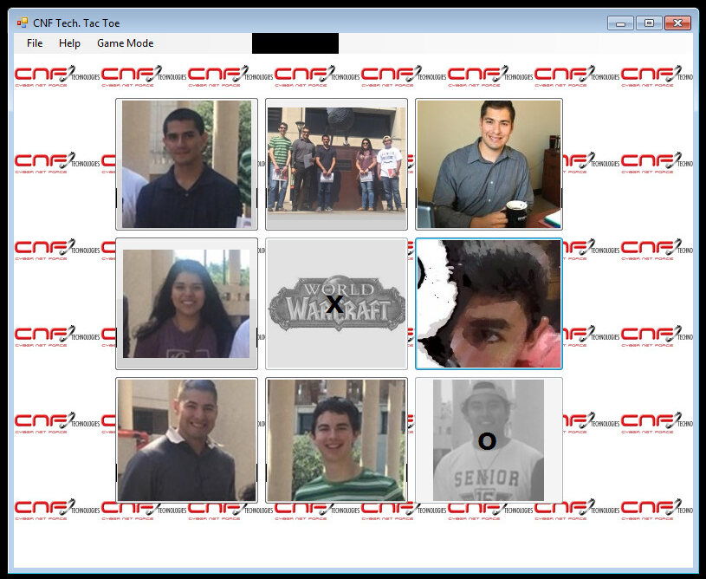

CNF Tech. Tac Toe
List the functions you will discuss
CNF Tech. Tac Toe
I named this application “CNF Tech. Tac Toe” because I specifically customized it to be for CNF employees and future CNF cyber security camp members.
What it does is sparks a little friendly competition between you and a CPU or with you and your peers, making an average day at work into an extraordinary one!

Slide 4
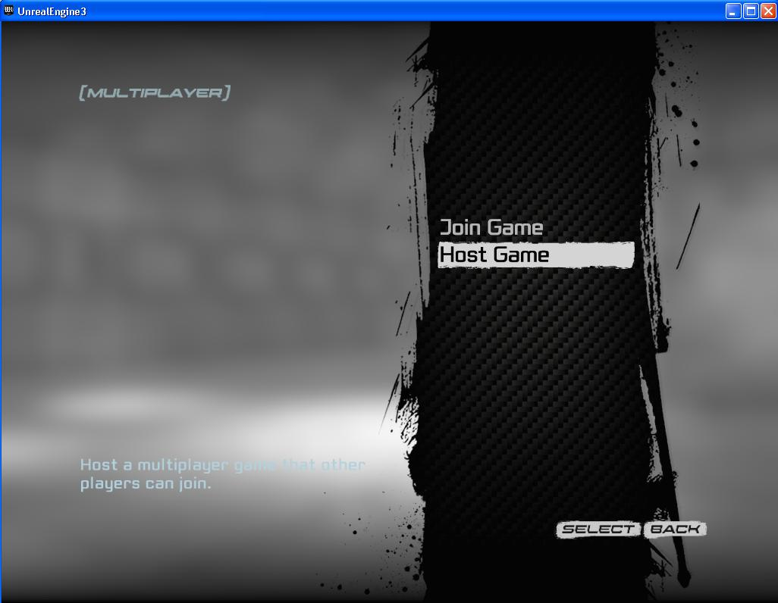
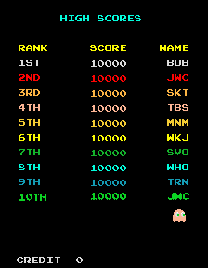
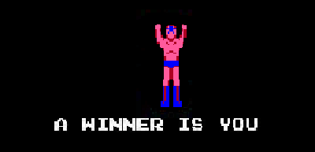
Future Features:
I plan to make the game design fully customizable, where you will be able to successfully upload any pictures to the buttons and background(for families, friends or other companies).
Add a online feature, where you can play with anyone around the office(or home) right in the comfort of your own desk.
Adding new animations, such as when you win an
Add online tournament system where the whole office(or family) can go head to head in order to win Tech Tac Toe-r of the month!

Slide 5



CNF Tech. Tac Toe
Why Your Application
Someone should choose this tic tac toe game over any other because everything on my application will be customizable and will be an online multiplayer.

Slide 6
CNF Tech. Tac Toe
Demonstration
Show your app
Let audience utilize app

Slide 7
Questions?

